Slide 1
Anaplan – Basic Functions
1 Contents
2 Landing page
3 Exporting to Excel
4 Fund filter
5 Expense filter
6 Search for data
7 Use of filters/refreshing data
8 Budget Landing Page
9 Budget Development
10 Budget Reconciliation

Slide 2
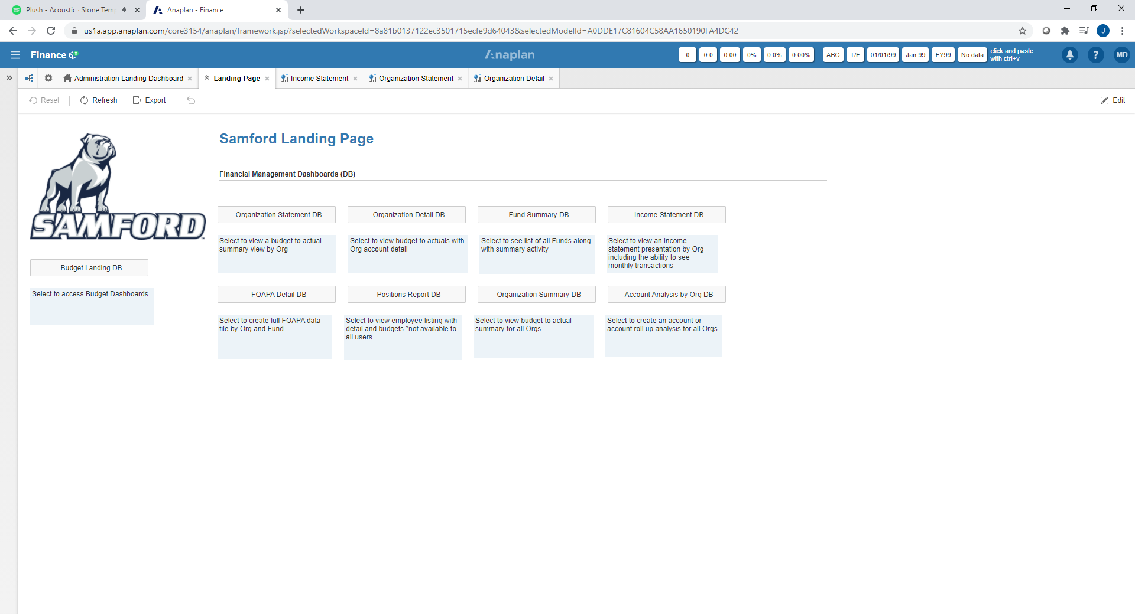
Dashboards
Learn to use these for your financial
management and analysis
Budget Development
For the annual budget development cycle

Slide 3
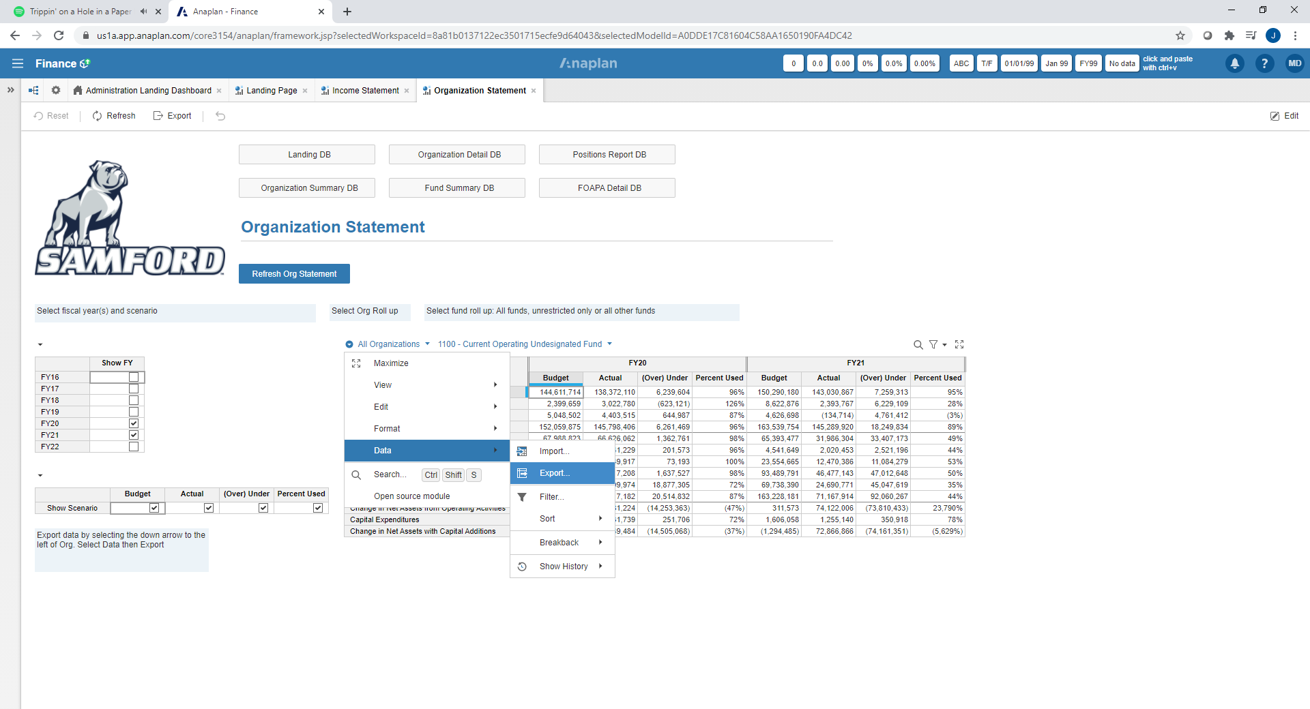
To export data to Excel
From any dashboard select this icon – select DATA – select EXPORT – hit RUN EXPORT

Slide 4
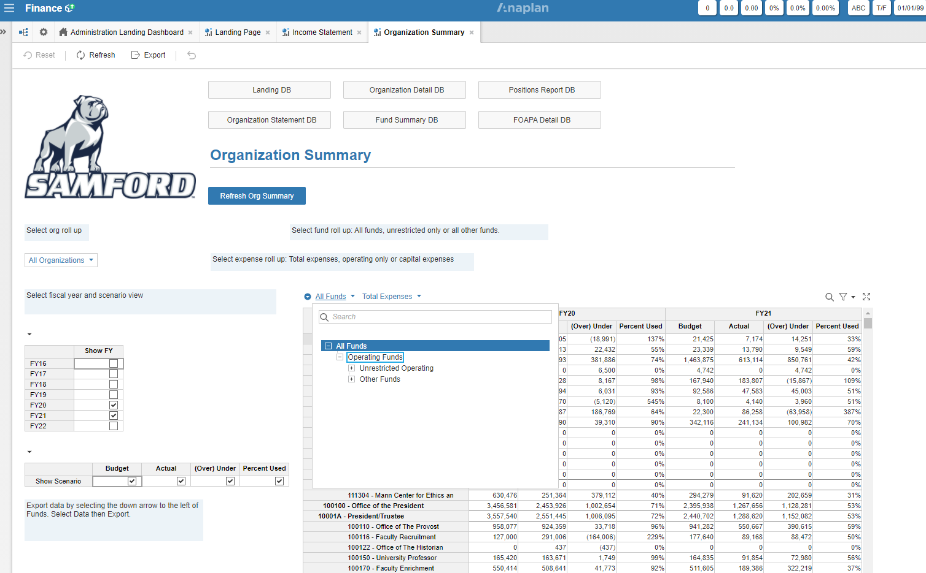
Use of the Fund filter
Select Unrestricted Operating for the 1100 Fund rollups (primary operating budgets)
Select Other Funds if you would like to limit the report to other funds such as endowments and gift funds.

Slide 5
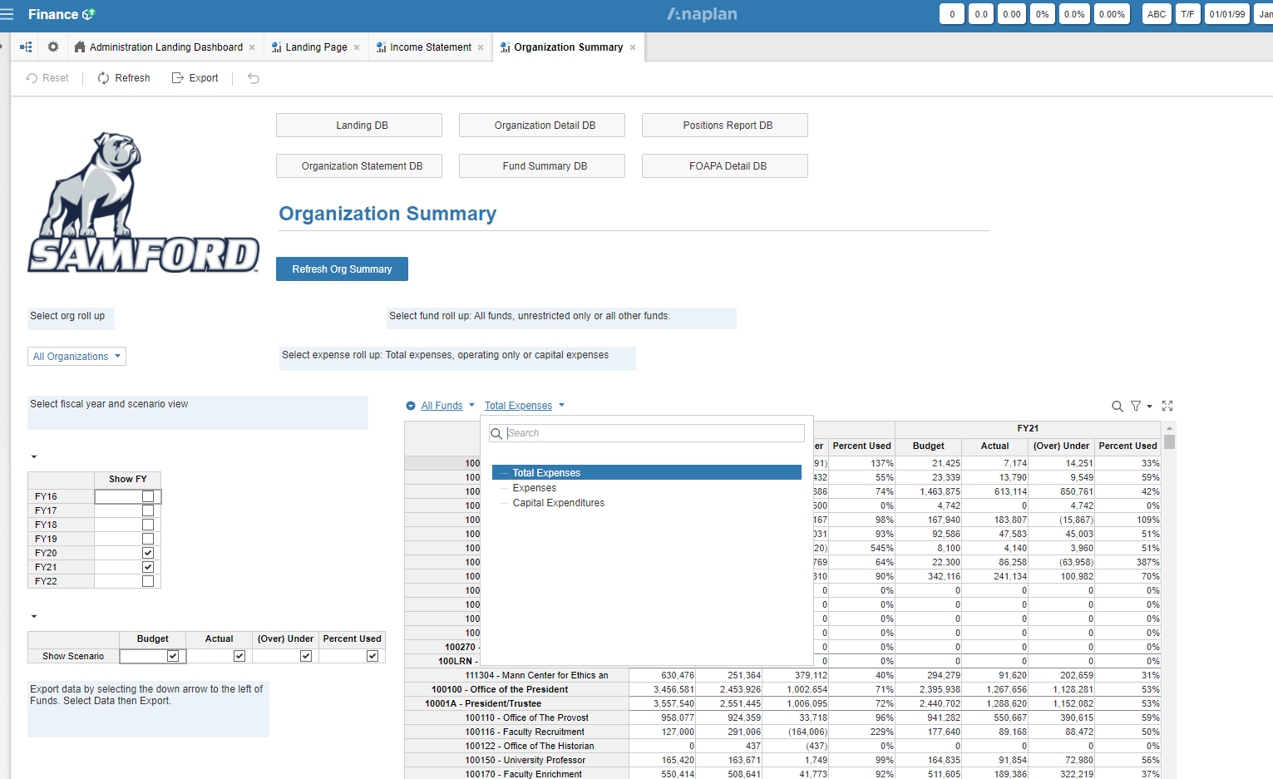
Use of the Expense filter
Select Expenses to exclude the capital account lines from the report
Select Capital Expenditures if you would like to limit the report to capital.

Slide 6
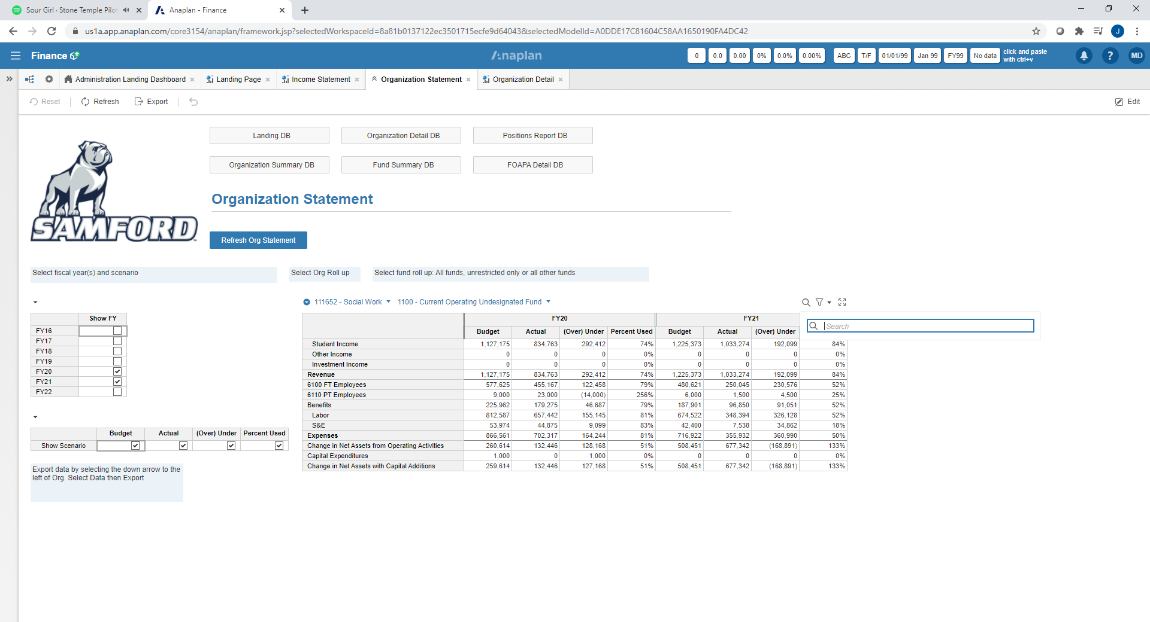
To search for data
You may have to hover over this area to
reveal icon

Slide 7
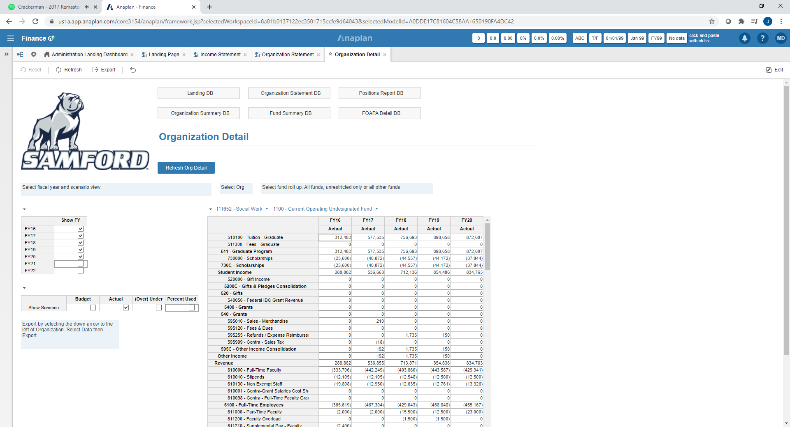
2) Refresh
To update data after filter changes
1) Use filters
These allow you to create helpful views

Slide 8
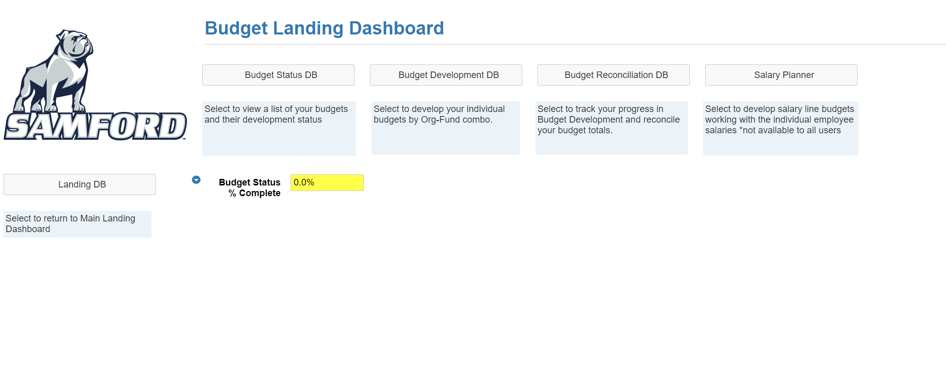
Key non-labor expense
budgets
Track overall budget
total and progress
Key salary budgets

Slide 9
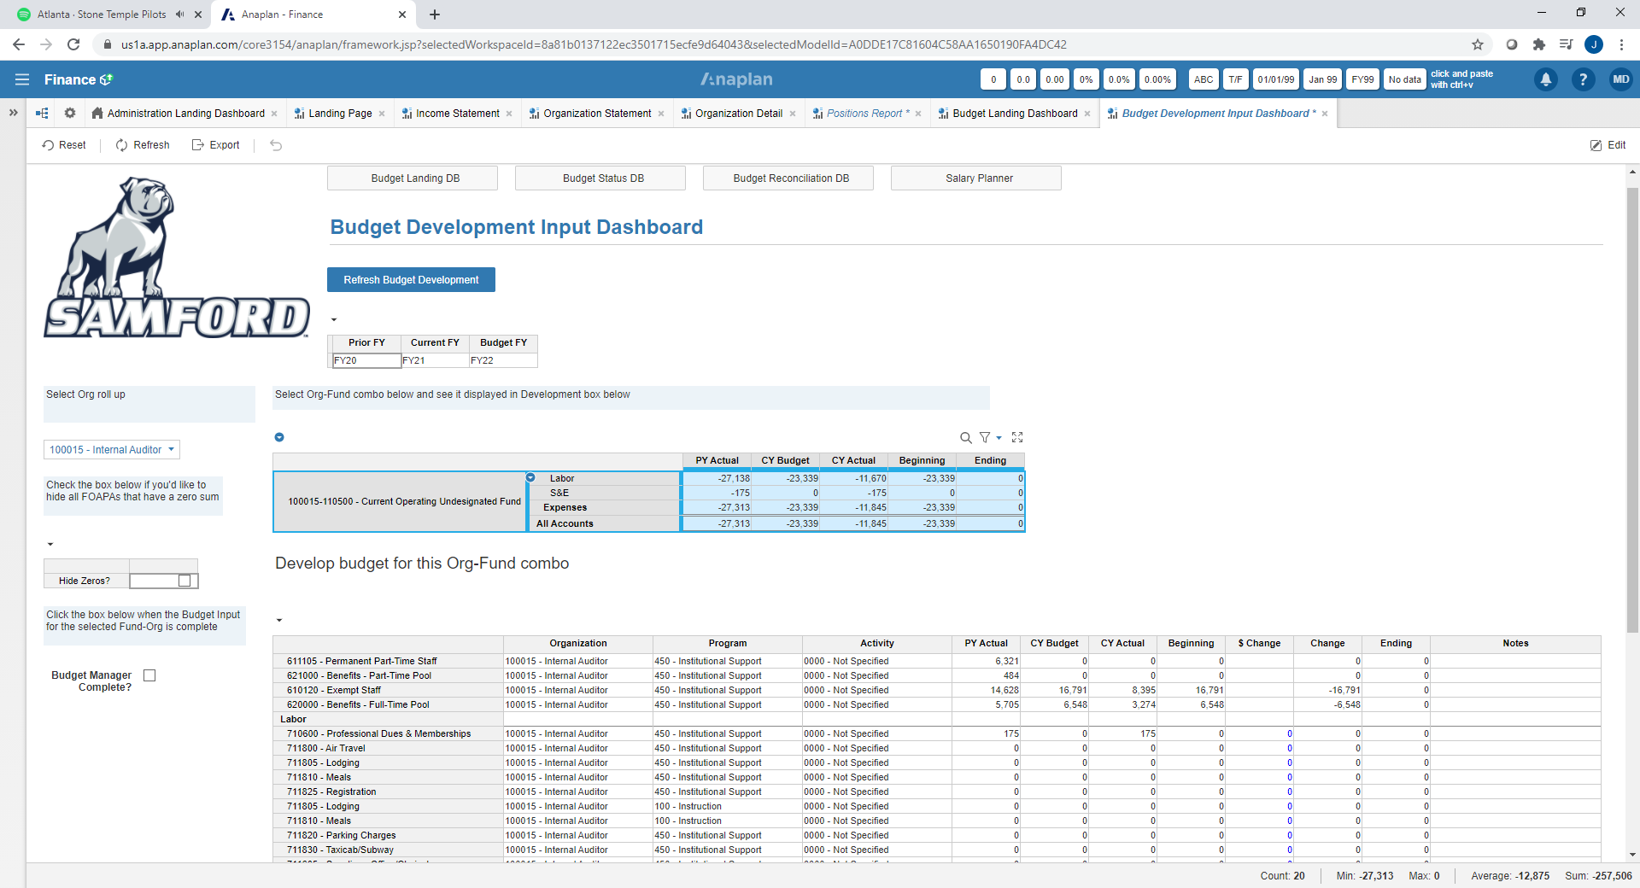
Select Org-Fund to work
Note current year budget and actuals for reference
2) Key changes
Note Blue $0 – allows data entry
key $ change to current amount

Slide 10
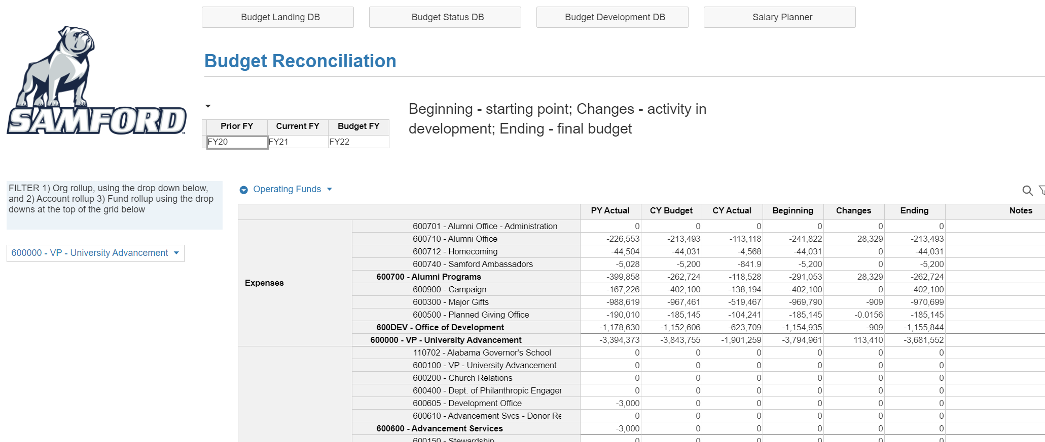
Development
Expense Budget;
Are you within your
assigned target?
Current period
Total Budget

